Slide 1

Working with Uploading Files

Slide 2
Simone Puorto
“When uploading a photo of your hotel online, you are the eyes of your guests.”

Slide 3



Notes:
https://www.youtube.com/channel/UC35ZpwldGw7ZJ5R-2sLijzw

Slide 4
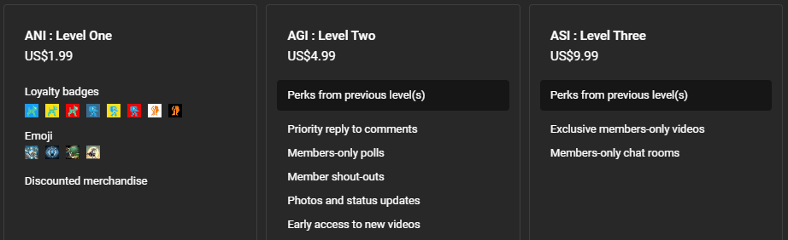

Membership has its privileges
Notes:
https://www.youtube.com/channel/UC35ZpwldGw7ZJ5R-2sLijzw/join

Slide 5
Files Overview
Uploading Files for the LLM
Notes:
https://platform.openai.com/docs/api-reference/files

Slide 6
Files
Used to upload documents that can be used with a variety of features:
Assistants
Fine-tuning
Batch processing
The size of all the files uploaded by one organization can be up to 100 GB.
The size of individual files can be a maximum of 512 MB or 2 million tokens.
Contact OpenAI if you need to increase these storage limits.
Notes:
https://platform.openai.com/docs/api-reference/files/create

Slide 7
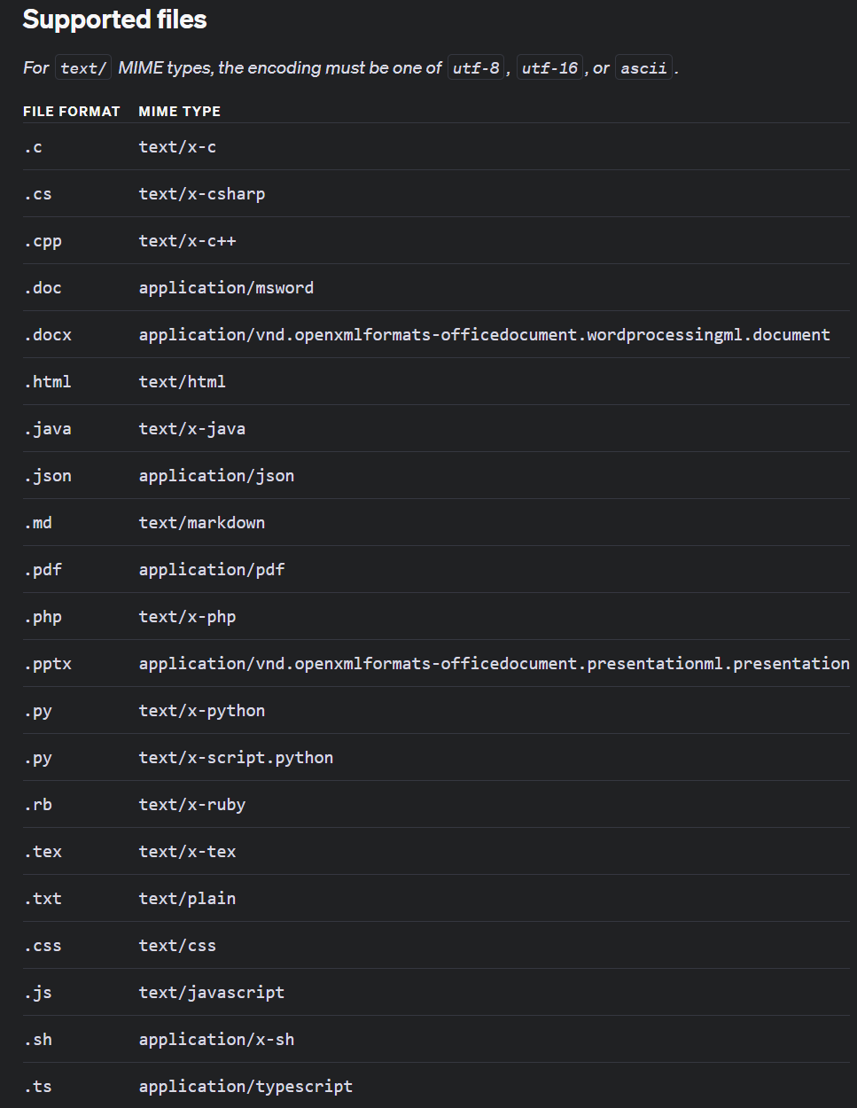
All common file extensions for text files, spreadsheets, presentations, and documents.
Notes:
https://platform.openai.com/docs/assistants/tools/file-search/supported-files?context=streaming

Slide 8
File Upload Flow
Upload Files
Obtain File ID
Use File ID with other endpoints

Slide 9
List Files
Show the Files We Have
Notes:
https://platform.openai.com/docs/api-reference/files/list

Slide 10
Get File ID by Name
Setting Up for Success in File Manipulation
Notes:
file_id = next((file.id for file in client.files.list(purpose="assistants").data if file.filename == "FirstFile.txt"), None)

Slide 11
Retrieve Files
Get Information About the File
Notes:
https://platform.openai.com/docs/api-reference/files/retrieve

Slide 12
Retrieve File Content
Get the Internal File Content
Notes:
https://platform.openai.com/docs/api-reference/files/retrieve-contents
https://community.openai.com/t/not-allowed-to-download-files-of-purpose-assistants/528220

Slide 13
Delete Files
Remove Files from Storage
Notes:
https://platform.openai.com/docs/api-reference/files/delete

Slide 14
Using the Interface
GUI is Good

Slide 15
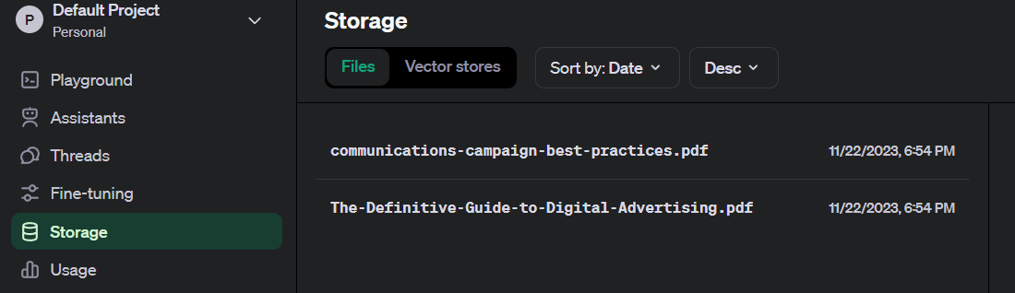

Slide 16
Using in Chat Completions
How to Use File Content in Chat Completions

Slide 17
